Slide 1

Artificial Neural Network (ann)
Heart Disease sampling
***Inspired by Udemy Deep Learning course
Created by Brian Crow

Slide 2
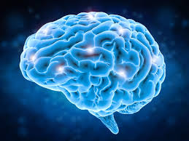
What is an Artificial Neural network?
Lets start with our brain
“The brain is one of the largest and most complex organs in the human body. It is made up of more than 100 billion nerves that communicate in trillions of connections called synapses...”
--WebMD
Each of the 100 billion nerves are called Neurons, the core of what makes our brains work. And each of the Neurons are connected to form individual neural networks.
-- http://www.human-memory.net/brain_neurons.html

Slide 3
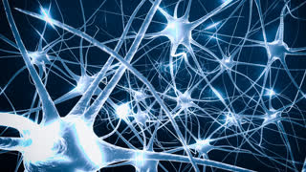
Neurons
A Neuron is?
Neuron. Neurons (also known as neurones, nerve cells and nerve fibers) are electrically excitable cells in the nervous system that function to process and transmit information. In vertebrate animals, neurons are the core components of the brain, spinal cord and peripheral nerves. Neuron - ScienceDaily https://www.sciencedaily.com/terms/neuron.htm

Slide 4

Neuron Composition
Cell Body or Soma is the nucleus of a neuron (nerve cell) from which one or more processes are received from or transmitted to (dendrites and/or axons)
Axon is the Transmitter to other Neurons. It is much longer than Dendrites, by up to a 1000x longer in some cases.
Dendrites are the Receivers and mostly connect to Axons.
Synaptic terminals are where the Axon and Dendrite connect. More commonly known as Synapse
***http://www.human-memory.net/brain_neurons.html
1
2
4
3

Slide 5
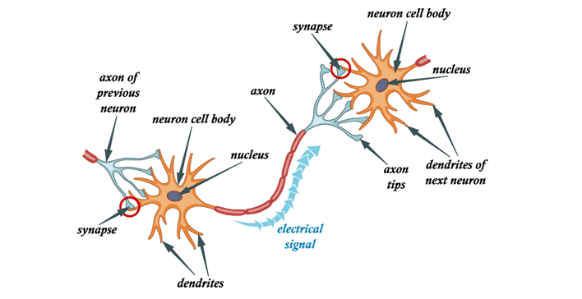
How it works
“Each individual neuron can form thousands of links with other neurons in this way, giving a typical brain well over 100 trillion synapses (up to 1,000 trillion, by some estimates).” ***http://www.human-memory.net/brain_neurons.html
“Functionally related neurons connect to each other to form neural networks (also known as neural nets or assemblies). The connections between neurons are not static, though, they change over time. The more signals sent between two neurons, the stronger the connection grows…” ***http://www.human-memory.net/brain_neurons.html

Slide 6
Applying What we’ve learned
N
N
Neuron
N
Input
Dendrites
Axon
Synapse
Synapse
N
N

Slide 7
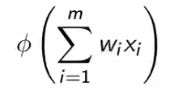

Simplified ann
Forward Propagation
Neuron
X1
W1
Output
X2
W2
X3
W3
Back Propagation
Input
Hidden Layer
Output Layer

Slide 8
How does ann work?
N
Each Input is a single row in the data set.
Xx equal the columns in the row and represent the Independent Variable
Each Xx needs to be standardized for summation
Wx equal the synapse but is also the weight
Nx is the weighted sum of the values in the row with the corresponding weight. Sum(X1*W1 + X2*W2….)
X1
W1
N
X2
W2
N
X3
O
W3
N
X4
N
X5
N
X6
N
Input
Hidden Layer
Output Layer

Slide 9
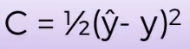
Back propogation
Most important step
Updates the weights based on the cost function
Cost function
Back propagate until the cost function is minimized.
You should always have a difference between output and actual.

Slide 10
Process steps of ann
Set the weights to near zero
Load the data set
Forward propagate thru the Neuron (Hidden Layer) to obtain output
Run Cost Function to see where if output and actual are close
Back propagate by updating weights
Forward propagate thru the Neuron (Hidden Layer) to obtain new output
Continue until the Cost function is near zero

Slide 11
Program-Prerequisites
Python Spyder (I’m using Anaconda which has Spyder)
System with high end GPU (Recommended but not required)
Theano library
Tensorflow library
Keras library

Slide 12
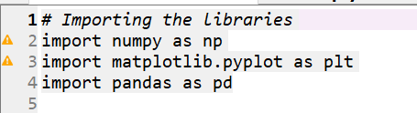
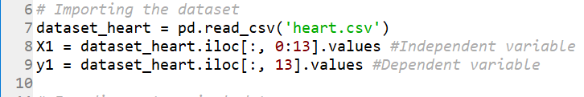
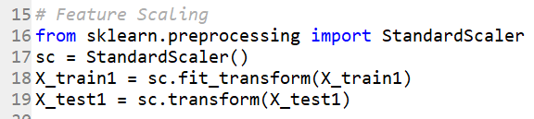
Getting the data ready
Load 3 libraries
Import the data and assign the X and y values
Train the data
Scale the data

Slide 13
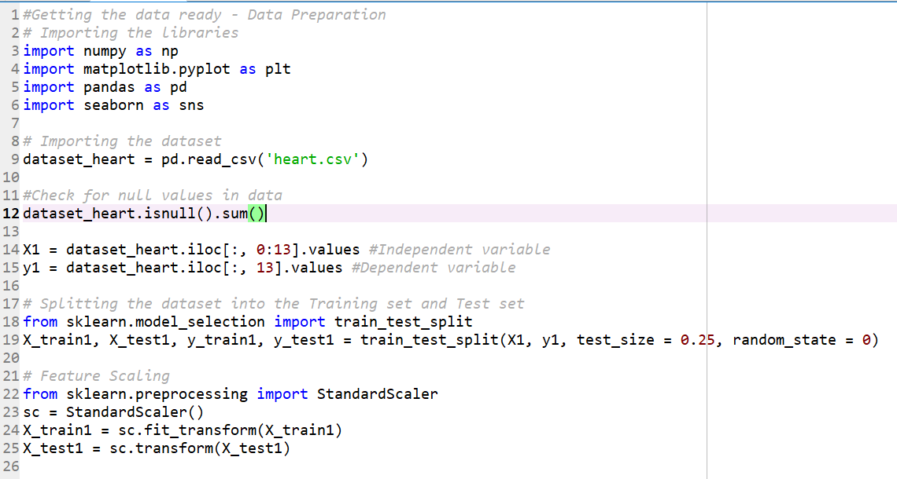
Loading data script

Slide 14
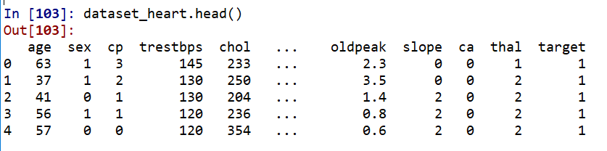
Reviewing our data
dataset_heart['target'].value_counts()
165 True for Heart Disease
138 False for Heart Disease
dataset_heart.head()

Slide 15
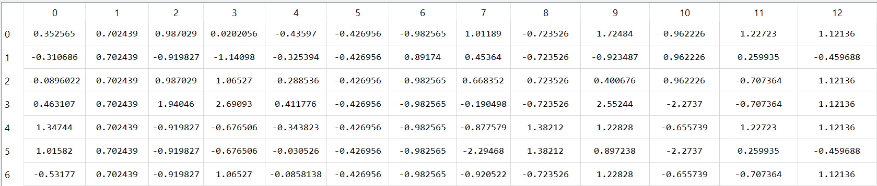
Reviewing our data
Train and Test should contain 12 columns of Independent Variables
Train is 75% of the total and should have 227 rows (303*.75)
Test is 25% of the total and should have 76 rows (303*.25)

Slide 16
Data defined
age- in years
sex-(1 = male; 0 = female)
cp- chest pain type
trestbps- resting blood pressure (in mm Hg on admission to the hospital)
chol- serum cholestoral in mg/dl
fbs-(fasting blood sugar > 120 mg/dl) (1 = true; 0 = false)
restecg-resting electrocardiographic results
thalach-maximum heart rate achieved
exang-exercise induced angina (1 = yes; 0 = no)
oldpeak-ST depression induced by exercise relative to rest
slope-the slope of the peak exercise ST segment
ca-number of major vessels (0-3) colored by flourosopy
thal- 3 = normal; 6 = fixed defect; 7 = reversable defect
target- 1 or 0

Slide 17
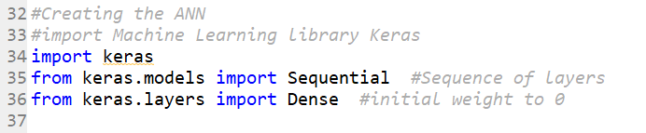
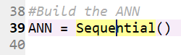
Building the ANN
First we need to load Keras to build the ANN
Since we are sequentially going thru the data we will create our ANN as ANN
The ANN consists of an Input Layer, Hidden Layer and Output layer. Here is the Input and Hidden Layer creation in one line of code.

Slide 18
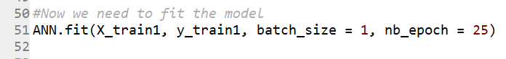
Building the ANN
Now we can build the Output layer
ANN needs to be compiled in order to run.
Now, the fun part. Let’s start training

Slide 19
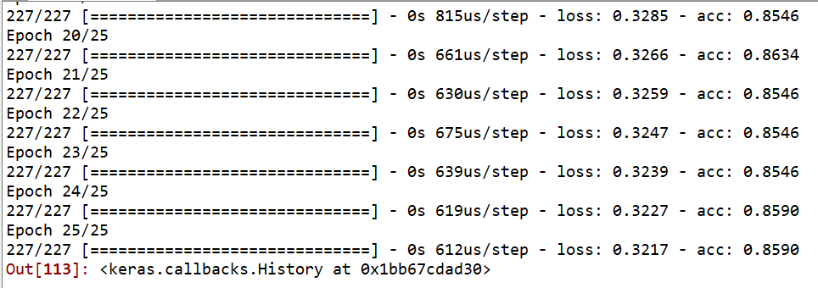
We now have an ANN
Here is our results

Slide 20
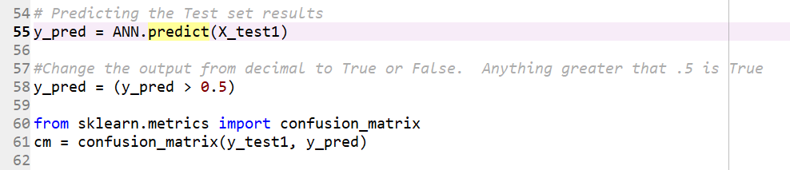
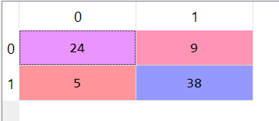
Analysis of what we have
Set up a confusion_matrix to analyze or predict what our accuracy is.
Here are the results: 24 No Heart Disease with 9 being wrong and 38 with Heart Disease and 5 being wrong. Adding all of them up totals 76

Slide 21
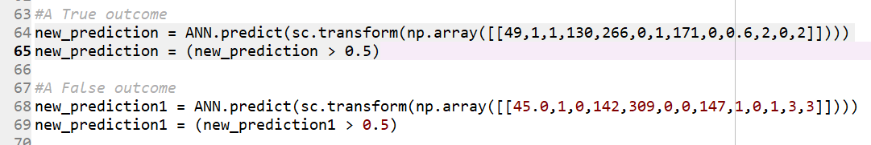
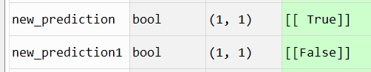
Lets test this
Lets input two new patients and see what the results are.
Results

Slide 22
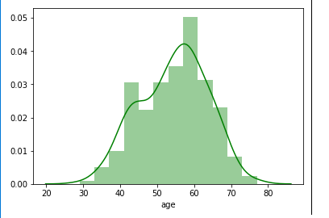
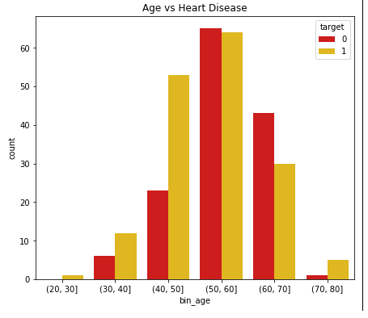
Standard Analysis
Ages 55 to 60 have the greatest chance of heart disease
Ages 40 to 50 show the greatest signs of Heart Disease
All Charts were based on scripts from https://www.kaggle.com/nitindatta/what-causes-heart-disease

Slide 23
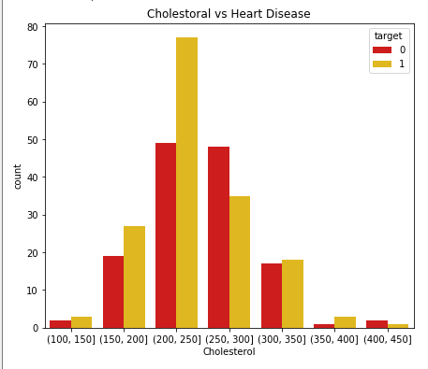
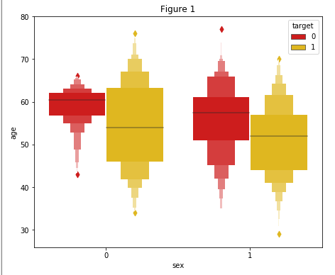
Standard analysis
Cholesterol
Men vs Women

Slide 24
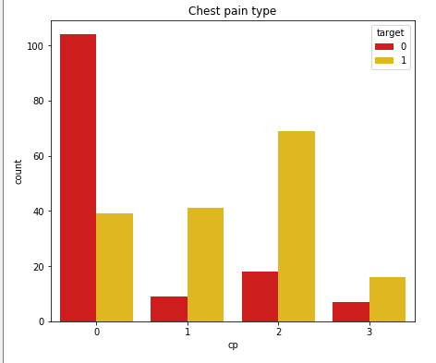
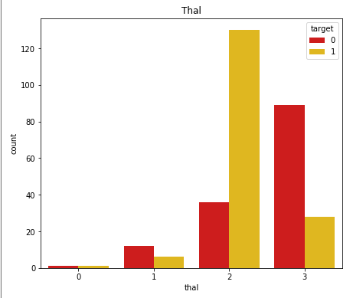
Standard analysis
CP – Chest Pain
Thal-Thalassemia

Slide 25
Conclusion

